Slide 1


The PiXL Club The PiXL Club The PiXL Club The PiXL Club The PiXL Club The PiXL Club The PiXL Club The PiXL Club The PiXL Club The PiXL Club The PiXL Club The PiXL Club The PiXL Club The PiXL Club The PiXL Club The PiXL Club The PiXL Club The PiXL Club The PiXL Club The PiXL Club The PiXL Club The PiXL Club The PiXL Club The PiXL Club The PiXL Club The PiXL Club The PiXL Club The PiXL Club The PiXL Club The PiXL Club The PiXL Club The PiXL Club The PiXL Club The PiXL Club The PiXL Club The PiXL Club The PiXL Club The PiXL Club The PiXL Club The PiXL Club The PiXL Club The PiXL Club The PiXL Club The PiXL Club The PiXL Club XL Club The PiXL Club The PiXL Club The PiXL Club The PiXL Club The PiXL Club The PiXL Club The PiXL Club The PiXL Club The PiXL Club The PiXL Club The PiXL Club The PiXL Club The PiXL Club The PiXL Club The PiXL Club The PiXL Club The PiXL Club The PiXL Club The PiXL Club The PiXL Club The PiXL Club The PiXL Club The PiXL Club The PiXL Club The PiXL Club The PiXL Club The PiXL Club The PiXL Club The PiXL Club The PiXL Club The PiXL Club The PiXL Club The PiXL Club The PiXL Club The PiXL Club The PiXL Club The PiXL Club The PiXL Club The PiXL Club The PiXL Club The PiXL Club The PiXL Club The PiXL Club The PiXL Club The PiXL Club The PiXL Club The PiXL Club The PiXL Club The PiXL Club The PiXL Club The PiXL Club The PiXL Club The PiXL Club The PiXL Club The PiXL Club The PiXL Club The PiXL Club The PiXL Club The PiXL Club The PiXL Club The PiXL Club The PiXL Club The PiXL Club The PiXL Club The PiXL Club The PiXL Club The PiXL Club The PiXL Club The PiXL Club The PiXL Club The PiXL Club The PiXL Club The PiXL Club The PiXL Club The PiXL Club The PiXL Club The PiXL Club The PiXL Club The PiXL Club The PiXL Club The PiXL Club The PiXL Club The PiXL Club The PiXL Club The PiXL Club The PiXL Club The PiXL Club The PiXL Club The PiXL Club The PiXL Club The PiXL Club The PiXL Club The PiXL Club The PiXL Club The PiXL Club The PiXL Club The PiXL Club The PiXL Club The PiXL Club The PiXL Club The PiXL Club The PiXL Club The PiXL Club The PiXL Club The PiXL Club The PiXL Club The PiXL Club The PiXL Club The PiXL Club The PiXL Club The PiXL Club The PiXL Club The PiXL Club The PiXL Club The PiXL Club The PiXL Club The PiXL Club The PiXL Club The PiXL Club The PiXL Club The PiXL Club The PiXL Club The PiXL Club The PiXL Club The PiXL Club The PiXL Club The PiXL Club The PiXL Club The PiXL Club The PiXL Club The PiXL Club The PiXL Club The PiXL Club The PiXL Club The PiXL Club The PiXL Club The PiXL Club The PiXL Club The PiXL Club The PiXL Club The PiXL Club The PiXL Club The PiXL Club The PiXL Club The PiXL Club The PiXL Club The PiXL Club The PiXL Club The PiXL Club The PiXL Club The PiXL Club The PiXL Club The PiXL Club The PiXL Club The PiXL Club The PiXL Club The PiXL Club The PiXL Club The PiXL Club The PiXL Club The PiXL Club The PiXL Club The PiXL Club The PiXL Club The PiXL Club The PiXL Club The PiXL Club The PiXL Club The PiXL Club The PiXL Club The PiXL Club The PiXL Club The PiXL Club The PiXL Club The PiXL Club The PiXL Club The PiXL Club The PiXL Club The PiXL Club The PiXL Club The PiXL Club The PiXL Club The PiXL Club The PiXL Club The PiXL Club The PiXL Club The PiXL Club The PiXL Club The PiXL Club The PiXL Club The PiXL Club The PiXL Club The PiXL Club The PiXL Club The PiXL Club The PiXL Club The PiXL Club The PiXL Club The PiXL Club The PiXL Club The PiXL Club The PiXL Club The PiXL Club The PiXL Club The PiXL Club The PiXL Club The PiXL Club The PiXL Club The PiXL Club The PiXL Club The PiXL Club The PiXL Club The PiXL Club The PiXL Club The PiXL Club The PiXL Club The PiXL Club The PiXL Club The PiXL Club The PiXL Club The PiXL Club The PiXL Club The PiXL Club The PiXL Club The PiXL Club The PiXL Club The PiXL Club The PiXL Club The PiXL Club The PiXL Club The PiXL Club The PiXL Club The PiXL Club The PiXL Club The PiXL Club The PiXL Club The PiXL Club The PiXL Club The PiXL Club The PiXL Club The PiXL Club The PiXL Club The PiXL Club The PiXL Club The PiXL Club The PiXL Club The PiXL Club The PiXL Club The PiXL Club The PiXL Club The PiXL Club The PiXL Club The PiXL Club The PiXL Club The PiXL Club The PiXL Club The PiXL Club The PiXL Club The PiXL Club The PiXL Club The PiXL Club The PiXL Club The PiXL Club The PiXL Club The PiXL Club The PiXL Club The PiXL Club The PiXL Club The PiXL Club The PiXL Club The PiXL Club The PiXL Club The PiXL Club The PiXL Club The PiXL Club The PiXL Club The PiXL Club The PiXL Club The PiXL Club The PiXL Club The PiXL Club The PiXL Club The PiXL Club The PiXL Club The PiXL Club The PiXL Club The PiXL Club The PiXL Club The PiXL Club The PiXL Club The PiXL Club The PiXL Club The PiXL Club The PiXL Club The PiXL Club The PiXL Club The PiXL Club The PiXL Club The PiXL Club The PiXL Club The PiXL Club The PiXL Club The PiXL Club The PiXL Club The PiXL Club The PiXL Club The PiXL Club The PiXL Club The PiXL Club The PiXL Club The PiXL Club The PiXL Club The PiXL Club The PiXL Club The PiXL Club The PiXL Club The PiXL Club The PiXL Club The PiXL Club The PiXL Club The PiXL Club The PiXL Club The PiXL Club The PiXL Club The PiXL Club The PiXL Club The PiXL Club The PiXL Club The PiXL Club The PiXL Club The PiXL Club The PiXL Club The PiXL Club The PiXL Club The PiXL Club The PiXL Club The PiXL Club The PiXL Club The PiXL Club The PiXL Club The PiXL Club The PiXL Club The PiXL Club The PiXL Club The PiXL Club The PiXL Club The PiXL Club The PiXL Club The PiXL Club The PiXL Club The PiXL Club The PiXL Club The PiXL Club The PiXL Club The PiXL Club The PiXL Club The PiXL Club The PiXL Club The PiXL Club The PiXL Club The PiXL Club The PiXL Club The PiXL Club The PiXL Club The PiXL Club The PiXL Club The PiXL Club The PiXL Club The PiXL Club The PiXL Club The PiXL Club The PiXL Club The PiXL Club The PiXL Club The PiXL Club The PiXL Club The PiXL Club The PiXL Club The PiXL Club The PiXL Club The PiXL Club The PiXL Club The PiXL Club The PiXL Club The PiXL Club The PiXL Club The PiXL Club The PiXL Club The PiXL Club The PiXL Club The PiXL Club The PiXL Club The PiXL Club The PiXL Club The PiXL Club The PiXL Club The PiXL Club The PiXL Club The PiXL Club The PiXL Club The PiXL Club The PiXL Club The PiXL Club The PiXL Club The PiXL Club The PiXL Club The PiXL Club The PiXL Club The PiXL Club The PiXL Club The PiXL Club The PiXL Club The PiXL Club The PiXL Club The PiXL Club The PiXL Club The PiXL Club The PiXL Club The PiXL Club The PiXL Club The PiXL Club The PiXL Club The PiXL Club The PiXL Club The PiXL Club The PiXL Club The PiXL Club The PiXL Club The PiXL Club The PiXL Club The PiXL Club The PiXL Club The PiXL Club The PiXL Club The PiXL Club The PiXL Club The PiXL Club The PiXL Club The PiXL Club The PiXL Club The PiXL Club The PiXL Club The PiXL Club The PiXL Club The PiXL Club The PiXL Club The PiXL Club The PiXL Club The PiXL Club The PiXL Club The PiXL Club The PiXL Club The PiXL Club The PiXL Club The PiXL Club The PiXL Club The PiXL Club The PiXL Club The PiXL Club The PiXL Club The PiXL Club The PiXL Club The PiXL Club The PiXL Club The PiXL Club The PiXL Club The PiXL Club The PiXL Club The PiXL Club The PiXL Club The PiXL Club The PiXL Club The PiXL Club The PiXL Club The PiXL Club The PiXL Club The PiXL Club The PiXL Club The PiXL Club The PiXL Club The PiXL Club The PiXL Club The PiXL Club The PiXL Club The PiXL Club The PiXL Club The PiXL Club The PiXL Club The PiXL Club The PiXL Club The PiXL Club The PiXL Club The PiXL Club The PiXL Club The PiXL Club The PiXL Club The PiXL Club The PiXL Club The PiXL Club The PiXL Club The PiXL Club The PiXL Club The PiXL Club The PiXL Club The PiXL Club The PiXL Club The PiXL Club The PiXL Club The PiXL Club The PiXL Club The PiXL Club The PiXL Club The PiXL Club The PiXL Club The PiXL Club The PiXL Club The PiXL Club The PiXL Club The PiXL Club The PiXL Club The PiXL Club The PiXL Club The PiXL Club The PiXL Club The PiXL Club The PiXL Club The PiXL Club The PiXL Club The PiXL Club The PiXL Club The PiXL Club The PiXL Club The PiXL Club The PiXL Club The PiXL Club The PiXL Club The PiXL Club The PiXL Club The PiXL Club The PiXL Club The PiXL Club The PiXL Club The PiXL Club The PiXL Club The PiXL Club The PiXL Club The PiXL Club The PiXL Club The PiXL Club The PiXL Club The PiXL Club The PiXL Club The PiXL Club The PiXL Club The PiXL Club The PiXL Club The PiXL Club The PiXL Club The PiXL Club The PiXL Club The PiXL Club The PiXL Club The PiXL Club The PiXL Club The PiXL Club The PiXL Club The PiXL Club The PiXL Club The PiXL Club The PiXL Club The PiXL Club The PiXL Club The PiXL Club The PiXL Club The PiXL Club The PiXL Club The PiXL Club The PiXL Club The PiXL Club The PiXL Club The PiXL Club The PiXL Club The PiXL Club The PiXL Club The PiXL Club The PiXL Club The PiXL Club The PiXL Club The PiXL Club The PiXL Club The PiXL Club The PiXL Club The PiXL Club The PiXL Club The PiXL Club The PiXL Club The PiXL Club The PiXL Club The PiXL Club The PiXL Club The PiXL Club The PiXL Club The PiXL Club The PiXL Club The PiXL Club The PiXL Club The PiXL Club The PiXL Club The PiXL Club The PiXL Club The PiXL Club The PiXL Club The PiXL Club The PiXL Club The PiXL Club The PiXL Club The PiXL Club The PiXL Club The PiXL Club The PiXL Club The PiXL Club The PiXL Club The PiXL Club The PiXL Club The PiXL Club The PiXL Club The PiXL Club The PiXL Club The PiXL Club The PiXL Club The PiXL Club The PiXL Club The PiXL Club The PiXL Club The PiXL Club The PiXL Club The PiXL Club The PiXL Club The PiXL Club The PiXL Club The PiXL Club The PiXL Club The PiXL Club The PiXL Club The PiXL Club The PiXL Club The PiXL Club The PiXL Club The PiXL Club The PiXL Club The PiXL Club The PiXL Club The PiXL Club The PiXL Club The PiXL Club The PiXL Club The PiXL Club The PiXL Club The PiXL Club The PiXL Club The PiXL Club The PiXL Club The PiXL Club The PiXL Club The PiXL Club The PiXL Club The PiXL Club The PiXL Club The PiXL Club The PiXL Club The PiXL Club The PiXL Club The PiXL Club The PiXL Club The PiXL Club The PiXL Club The PiXL Club The PiXL Club The PiXL Club The PiXL Club The PiXL Club The PiXL Club The PiXL Club The PiXL Club The PiXL Club The PiXL Club The PiXL Club The PiXL Club The PiXL Club The PiXL Club The PiXL Club The PiXL Club The PiXL Club The PiXL Club The PiXL Club The PiXL Club The PiXL Club The PiXL Club The PiXL Club The PiXL Club
PiXL KnowIT!
GCSE Chemistry
AQA Topic – Energy Changes
© Copyright The PiXL Club Ltd, 2017
This resource is strictly for the use of member schools for as long as they remain members of The PiXL Club. It may not be copied, sold nor transferred to a third party or used by the school after membership ceases. Until such time it may be freely used within the member school.
All opinions and contributions are those of the authors. The contents of this resource are not connected with nor endorsed by any other company, organisation or institution.
www.pixl.org.uk The PiXL Club Ltd, Company number 07321607

Slide 2
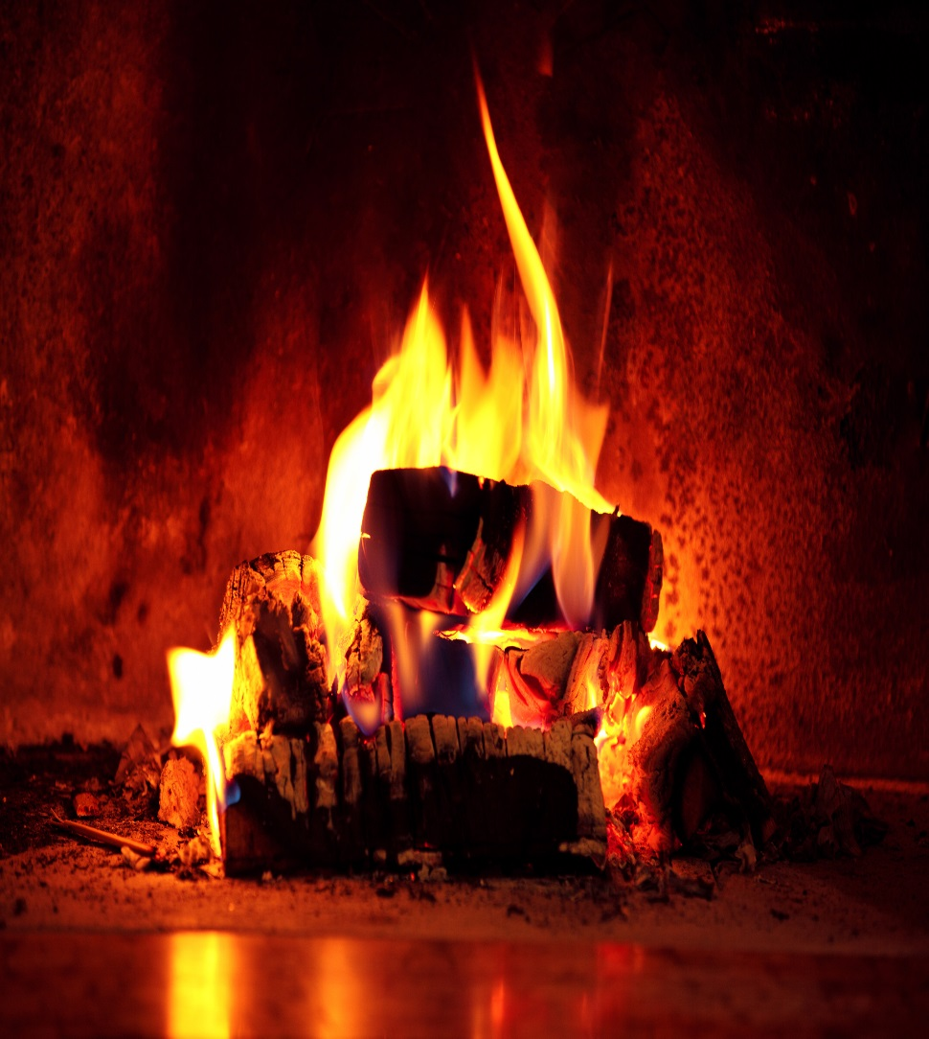
Overview
Energy Changes
Exothermic and endothermic reactions
  Energy changes during exothermic and endothermic reactions
  Reaction profiles
  The energy change of reactions (HT only)
Chemical cells and fuel cells (Chemistry only)
  Cells and batteries
  Fuel cells

Slide 3
LearnIT!
KnowIT!
Exothermic and
Endothermic
reactions
Exothermic reactions
Endothermic reactions

Slide 4
  Exothermic and endothermic reactions part 1 – Exothermic reactions
Energy is conserved in chemical reactions. The amount of energy in the Universe at the end of a chemical reaction is the same as before the reaction takes place.
H₂ (g) + Cl₂ (g) → 2HCl (g)
In the above reaction energy is released, it gets hotter.
An exothermic reaction is one that transfers energy to the surroundings so the temperature of the surroundings increases – “it gets hotter”.
The two HCl molecules made will not hold as much energy as the H₂ and Cl₂ molecules at the start, so the spare energy is released as heat.

Slide 5
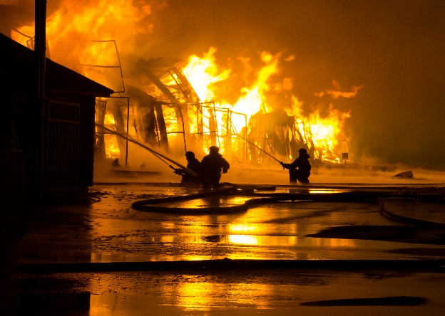

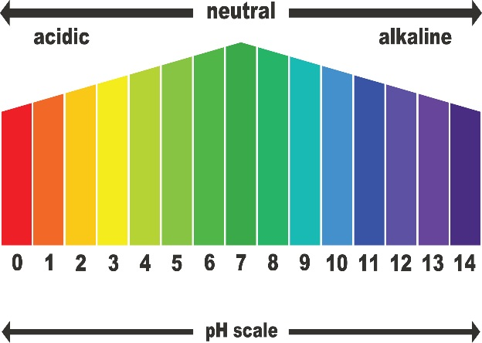
  Exothermic and endothermic reactions part 1 – Exothermic reactions
There are a number of common exothermic reactions, they include:
Combustion
Oxidation
Neutralisation
Know all three of these examples of exothermic reactions
Everyday uses of exothermic reactions include –
Self-heating cans
Hand warmers
Know both of these uses for exothermic reactions

Slide 6
  Exothermic and endothermic reactions part 1 – Endothermic reactions
We have already learnt that energy is conserved in chemical reactions.
2CH₃COOH(aq) + Na₂CO₃(s) → 2CH₃COONa(aq) + CO₂(g) + H₂O (l)
In the above reaction, energy is taken in- it gets colder.
An endothermic reaction is one that takes energy from the surroundings so the temperature of the surroundings decreases – “it gets colder”.
The sodium ethanoate, carbon dioxide and water molecules made will hold more energy than the ethanoic acid and sodium carbonate molecules at the start, so the energy needed is
taken in as heat.
Know all three of these examples of endothermic reactions
Other examples of endothermic reactions are
Thermal decomposition
Sports injury packs

Slide 7
QuestionIT!
Energy Changes
Part 1
Exothermic reactions
Endothermic reactions

Slide 8
  Energy Changes part 1 – QuestionIT
1. How would you know if an exothermic reaction had occurred?
2. How would you know if an endothermic reaction had occurred?
3. Below is a table of results for four reactions, the temperatures before and after the reactions are also given.
a/ Which reaction is endothermic? Explain how you know this.
b/ Which reaction is exothermic? Explain how you know this.
Reaction | Temperature at start ^{O}C | Temperature at end ^{O}C
A | 22 | 28
B | 20 | 20
C | 21 | 12
D | 25 | 25

Slide 9

AnswerIT!
Energy Changes
Part 1
Exothermic reactions
Endothermic reactions

Slide 10
  Energy Changes part 1 – AnswerIT
How would you know if an exothermic reaction had occurred?
The reaction would give out heat/get warmer/ temperature increase.
2. How would you know if an endothermic reaction had occurred?
The reaction would take in heat/get colder/ temperature decrease.

Slide 11
  Energy Changes part 1 – AnswerIT
3. Below is a table of results for four reactions, the temperatures before and after the reactions are also given.
a/ Which reaction is endothermic? Explain how you know this.
Reaction C, it gets colder/temperature falls.
b/ Which reaction is exothermic? Explain how you know this.
Reaction A, it gets warmer/temperature increases.
Reaction | Temperature at start ^{O}C | Temperature at end ^{O}C
A | 22 | 28
B | 20 | 20
C | 21 | 12
D | 25 | 25

Slide 12
LearnIT!
KnowIT!
Energy Changes
Part 2
Reaction profiles
The energy change of reactions (HT only)

Slide 13
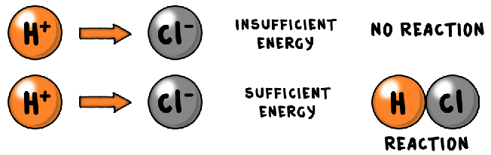
  Energy Changes part 2 – Reaction profiles
Chemical reactions can only occur when reacting particles collide with each other with sufficient energy.
The minimum amount of energy that particles must have to react is called the activation energy
You have given a reaction its activation energy when you have used a lit spill to light a Bunsen burner. Without the activation energy from the lit spill the methane gas and oxygen in the air will not combust and release the heat energy.
You will be expected to balance this equation.
When we look at this reaction we see the following.
CH₄ + 2O₂ → CO₂ + 2H₂O

Slide 14
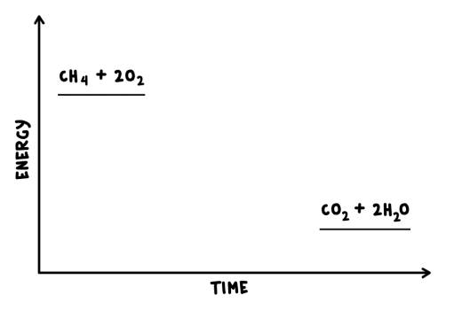
  Energy Changes part 2 – Reaction profiles
CH₄ + 2O₂ → CO₂ + 2H₂O
We know this reaction is exothermic, this means energy is released. So the CH₄ and 2O_{2 ,} the reactants, must have more energy than the products, CO₂ and 2H₂O
We can show this as a reaction profile. On it we need to include the formulae or names of the products and reactants. We also need to show the relative energies of the reactants and products e.g.

Slide 15
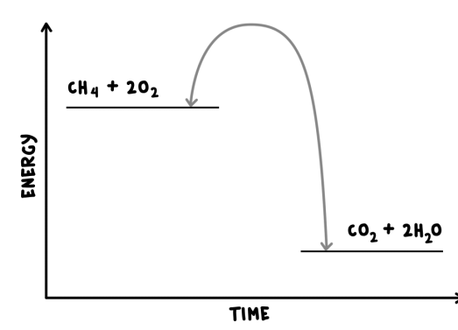
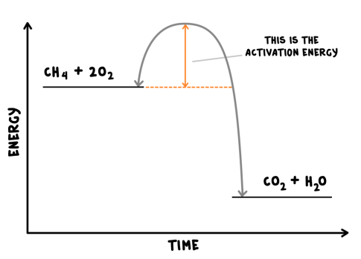
  Energy Changes part 2 – Reaction profiles
More information needs to be included in the reaction profile.
This will show the activation energy of the reaction. It is shown by a curved line rising above the reactants energy.

Slide 16
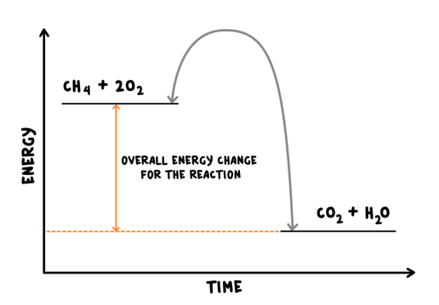
  Energy Changes part 2 – Reaction profiles
We can now see the overall change in energy within the reaction.
The products have less energy than the reactants. This will have been lost as heat as the reaction is exothermic.

Slide 17
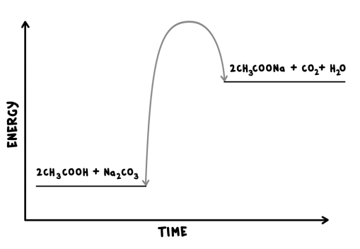
  Energy Changes part 2 – Reaction profiles
We saw earlier that the following reaction was endothermic:
2CH₃COOH(aq) + Na₂CO₃(s) → 2CH₃COONa(aq) + CO₂(g) + H₂O (l)
What would the reaction profile look like for this reaction?
We can see that the products have more energy than the reactants. This will have been taken in as heat energy it feels colder.

Slide 18
QuestionIT!
Energy Changes part 2
Activation energy
Reaction profiles

Slide 19
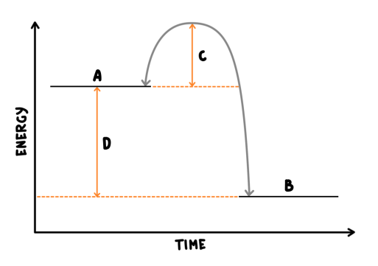
  Energy Changes part 2 QuestionIT
1. What is meant by the term activation energy?
2. On the reaction profile below what is shown by the letters?
A
B
C
D

Slide 20
  Energy Changes part 2 QuestionIT
3. What two things are needed for a chemical reaction to occur?
4. What is an exothermic reaction?
5. What is an endothermic reaction?

Slide 21
AnswerIT!
Energy Changes part 2
Activation energy
Reaction profiles

Slide 22
  Energy Changes part 2 AnswerIT
What is meant by the term activation energy?
The minimum amount of energy that particles must have to react.
2. On the reaction profile below what is shown by the letters?
A Reactants
B Products
C Activation energy
D Overall energy change/that the reaction is exothermic

Slide 23
  Energy Changes part 2 AnswerIT
3. What two things are needed for a chemical reaction to occur?
Reacting particles collide with each other and with sufficient energy.
4. What is an exothermic reaction?
Heat energy given out/energy lost to the surroundings
5. What is an endothermic reaction?
Heat energy taken in/energy taken in from the surroundings

Slide 24
LearnIT!
KnowIT!
The energy change
of reactions
(Higher Tier
only)

Slide 25
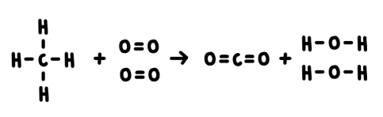
  The energy change of reactions (HT only)
For the reaction of methane with oxygen we can write out the balanced symbol equation:
CH₄ + 2O₂ → CO₂ + 2H₂O
We can draw out the bonds between the atoms e.g.
Each line represents a bond, two lines represent a double bond e.g. in the oxygen molecule.

Slide 26
  The energy change of reactions (HT only)
During a chemical reaction:
Energy must be supplied to break bonds in the reactants
Energy is released to form bonds in the products.
The energy needed to break bonds and the energy released when bonds are formed can be calculated from bond energies.
Bond | Bond Energy kJ/mol
C-H | 411
O=O | 494
C=O | 799
O-H | 459
This means that 411kJ/mol of energy needs to be put in to break the carbon-hydrogen bond.
It also means that 459 kJ/mol is given out when the oxygen hydrogen bond is made in water.

Slide 27
  The energy change of reactions (HT only)
The difference between the sum of the energy needed to break bonds in the reactants and the sum of the energy released when bonds in the products are formed is the overall energy change of the reaction.
Worked example
For the reactants | For the products
There are four C-H bonds so 4 x 411kJ/mol = 1,644kJ/mol | There are two C=O bonds so 2 x 799kJ/mol = 1,598kJ/mol
There are two O=O bonds so 2 x 494kJ/mol = 988kJ/mol | There are four O-H bonds so 4 x 459kJ/mol = 1,836kJ/mol
The sum of these is the energy supplied to break the bonds in the reactants it is 1,644 + 988 = 2,632kJ/mol | The sum of these is the energy released when bonds in the products are formed it is 1,598 + 1,836 = 3,434kJ/mol

Slide 28
  The energy change of reactions (HT only)
We already know that the difference between the sum of the energy needed to break bonds in the reactants and the sum of the energy released when bonds in the products are formed is the overall energy change of the reaction.
This means that
Overall energy change = energy needed to – energy released as break the bonds bonds are made
= 2,632kJ/mol - 3,434kJ/mol
Overall energy change = - 802kJ/mol
This is an exothermic reaction, so the sum of the difference between the calculations is negative. For an endothermic reaction it would be positive.
Students should be able to calculate the energy transferred in chemical reactions using bond energies supplied.

Slide 29
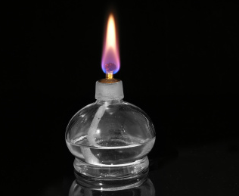
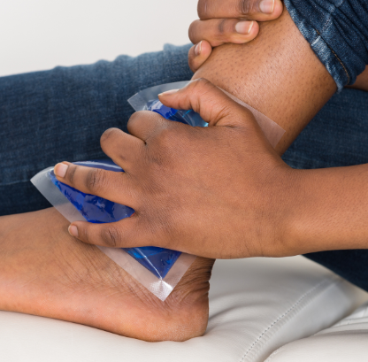
  The energy change of reactions (HT only)
Know these two definitions- they are often asked for in the exam.
In an exothermic reaction, the energy released from forming new bonds is greater than the energy needed to break existing bonds
In an endothermic reaction, the energy needed to break existing bonds is greater then the energy released from forming new bonds

Slide 30
QuestionIT!
The energy change
of reactions
(Higher Tier
only)

Slide 31
  The energy change of reactions (HT only) QuestionIT
1. Which process is exothermic, bond breaking or bond making?
2. Explain your answer to question 1.
3. How do we calculate the overall energy change of a reaction?

Slide 32
  The energy change of reactions (HT only) QuestionIT
4. The bond energy between a hydrogen and a nitrogen atom is 386 kJ/mol, the bond energy between two hydrogen atoms is 432 kJ/mol and the bond energy between two nitrogen atoms is 942kJ/mol. Using these bond energies, calculate the overall energy change for the following reaction.
2NH₃ → N₂ + 3H₂
5. Is the reaction exothermic or endothermic? Explain your answer.

Slide 33
AnswerIT!
The energy change
of reactions
(Higher Tier
only)

Slide 34
  The energy change of reactions (HT only) AnswerIT
1. Which process is exothermic, bond breaking or bond making?
Bond making
2. Explain your answer to question 1
Energy is released/temperature increases
3. How do we calculate the overall energy change of a reaction?
  It is the difference between the sum of the energy needed to break bonds in the reactants and the sum of the energy released when bonds in the products are formed.

Slide 35
  The energy change of reactions (HT only) AnswerIT
4. The bond energy between a hydrogen and a nitrogen atom is 386 kJ/mol, the bond energy between two hydrogen atoms is 432 kJ/mol and the bond energy between two nitrogen atoms is 942kJ/mol. Using these bond energies calculate the overall energy change for the following reaction.
2NH₃ → N₂ + 3H₂
For the reactants There are three nitrogen to hydrogen bonds in each molecule and there are two molecules so 386kJ/mol x 6 = 2,316kJ/mol | For the products There are three hydrogen to hydrogen bonds (432kJ/mol) and one nitrogen to nitrogen triple bond so 3 x 432kJ/mol + 942kJ/mol = 2,238kJ/mol
Overall energy change = energy needed to – energy released as break the bonds bonds are made
2,316kJ/mol - 2,238kJ/mol
Overall energy change = + 78kJ/mol
5. Is the reaction exothermic or endothermic? Explain your answer.
The reaction is endothermic as the overall energy change is positive.

Slide 36
LearnIT!
KnowIT!
Chemical Cells And
Fuel Cells (Chemistry
Only)
Cells And Batteries
Fuel Cells

Slide 37
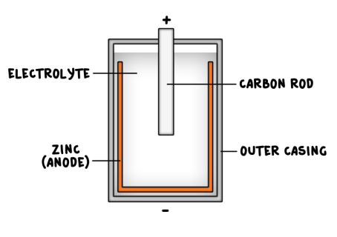
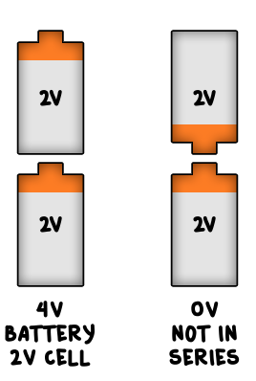
  Cells and batteries (Chemistry only)
Cells contain chemicals which react to produce electricity.
The voltage produced by a cell is dependent upon a number of factors including the type of electrode and electrolyte.
A simple cell can be made by connecting two different metals in contact with an electrolyte.
Batteries consist of two or more cells connected together in series to provide a greater voltage.
In non-rechargeable cells and batteries the chemical reactions stop when one of the reactants has been used up. Alkaline batteries are non-rechargeable.
Rechargeable cells and batteries can be recharged because the chemical reactions are reversed when an external electrical current is supplied.

Slide 38
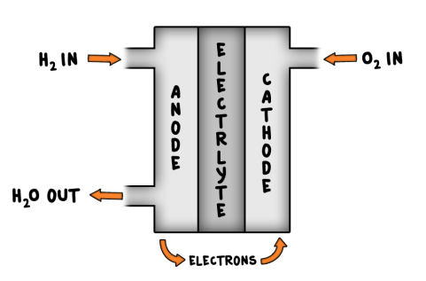
  Fuel Cells (Chemistry only)
Fuel cells are supplied by an external source of fuel (e.g. hydrogen) and oxygen or air. The fuel is oxidised electrochemically within the fuel cell to produce a potential difference (a voltage).
The overall reaction in a hydrogen fuel cell involves the oxidation of hydrogen to produce water.
hydrogen + oxygen → water
2H₂ (g) + O₂ (g)→ 2H₂O (g)
(Higher Tier only)
There are two electrodes in the hydrogen fuel cell.
At the cathode (+ charged)
2H₂ (g) → 4H⁺ (aq) + 4e⁻
At the anode (- charged)
4H⁺ (aq) + O₂ (g) + 4e⁻ → 2H₂O (g)
The half equations are only needed for the higher tier, however they are very important and worth revising carefully
Hydrogen fuel cells offer a potential alternative to rechargeable cells and batteries.

Slide 39
QuestionIT!
Chemical Cells And
Fuel Cells (Chemistry
Only)
Cells And Batteries
Fuel Cells

Slide 40
  Cells and batteries (Chemistry only)QuestionIT
1. Give two factors which may affect the voltage given out by a battery.
2. Here is a reactivity series of metals. The most reactive is first, the least reactive is last: Magnesium Zinc Tin Copper
Which two metals would you use to make a battery which had the highest voltage? Explain why.
3. Why do non-renewable batteries stop producing a voltage after a certain time?
4. How are rechargeable batteries recharged?

Slide 41
  Fuel Cells (Chemistry only)QuestionIT
1. What chemical is the fuel in a fuel cell ?
2. What happens to this fuel inside the fuel cell to produce a potential difference?
3. Write the overall balanced symbol equation for the reaction in a fuel cell.
4. Write the half equation for the reaction that happens at the cathode in a fuel cell.
5. Write the half equation for the reaction that happens at the anode in a fuel cell.

Slide 42
AnswerIT!
Chemical Cells And
Fuel Cells (Chemistry
Only)
Cells And Batteries
Fuel Cells

Slide 43
  Cells and batteries (Chemistry only)AnswerIT
1. Give two factors which may affect the voltage given out by a battery.
The type of electrode and the electrolyte
2. Here is a reactivity series of metals. The most reactive is first, the least reactive is last. Magnesium Zinc Tin Copper
Which two metals would you use to make a battery which gave off the most voltage? Explain why
Magnesium and copper as largest difference in reactivity.
3. Why do non-renewable batteries stop producing a voltage after a certain time?
The chemical reactions stop when one of the reactants has been used up.
4. How are rechargeable batteries recharged?
The chemical reactions are reversed by an external electrical current.

Slide 44
  Fuel Cells (Chemistry only)AnswerIT
1. What chemical is the fuel in a fuel cell ?
Hydrogen.
2. What happens to this fuel inside the fuel cell to produce a potential difference?
It is oxidised electrochemically.
3. Write the overall balanced symbol equation for the reaction in a fuel cell.
2H₂ (g) + O₂ (g)→ 2H₂O (g)
4. Write the half equation for the reaction that happens at the cathode in a fuel cell.
2H₂ (g) → 4H⁺ (aq) + 4e⁻
5. Write the half equation for the reaction that happens at the anode in a fuel cell.
4H⁺ (aq) + O₂ (g) + 4e⁻ → 2H₂O (g)

